Slide 1

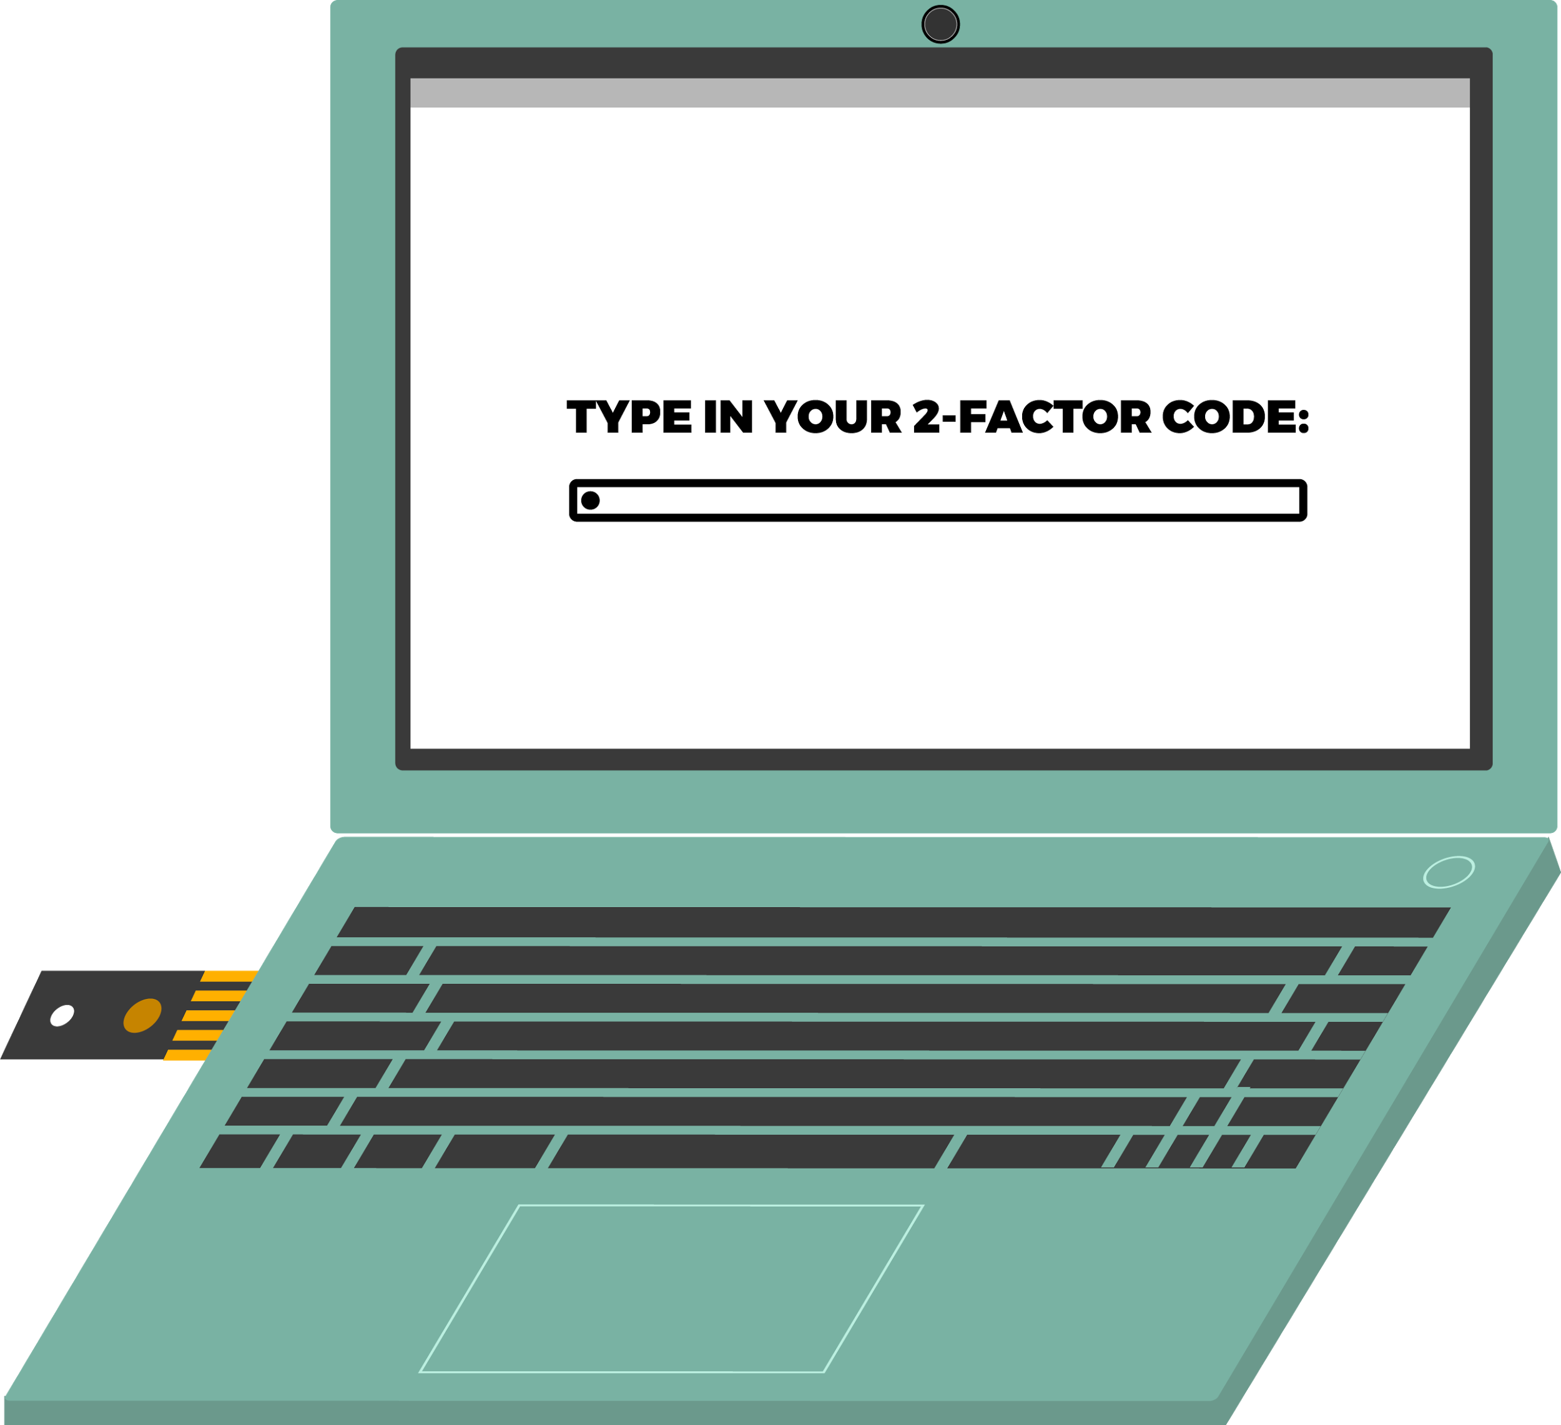
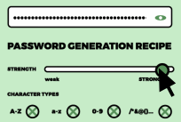

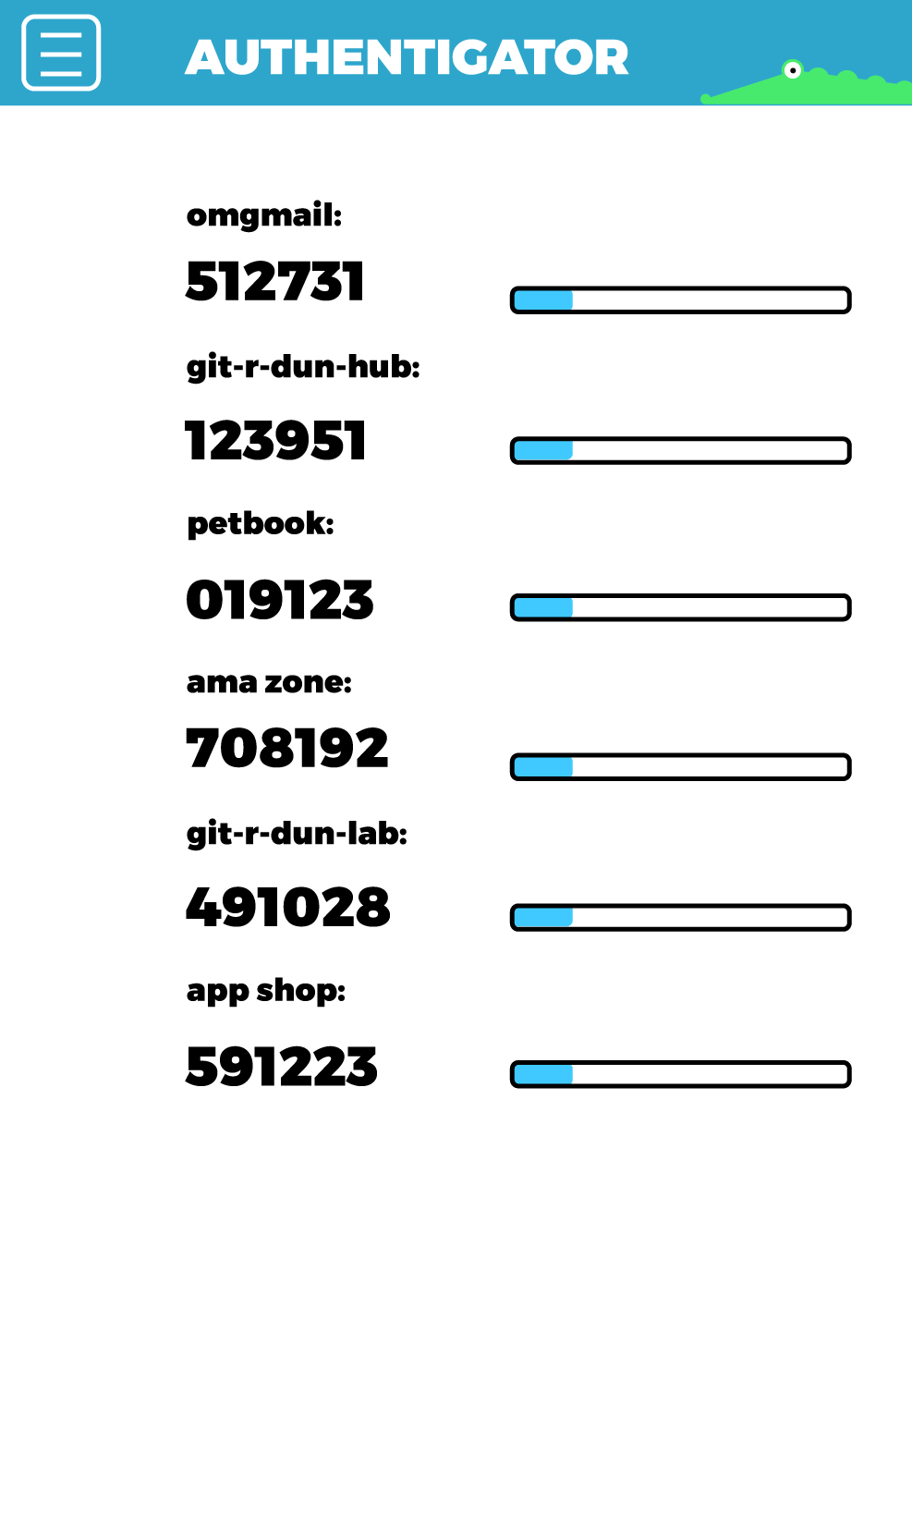

TWO-FACTOR
AUTHENTICATION
FOR MORE INFORMATION:
SECURITYEDUCATIONCOMPANION.ORG
TWO-FACTOR AUTHENTICATION is known by many names, such as 2FA, Two-Factor Auth, Two-Step Verification, Multifactor Authentication, MFA, and so on. You can learn more at:https://eff.org/common2FA. It’s generally defined as:
Something you know
This is the first factor: your username and password.
2) Something you have
This is the second factor: your device that you carry with you.
Follow the suggested guidelines to bump up your account security!
SOMETHING YOU KNOW:
USE STRONG PASSWORDS
EACH PASSWORD
FOR EACH ACCOUNT
SHOULD BE:
Random
Long
Unique
Check out EFF’s guide on generating strong passwords:
https://ssd.eff.org/en/module/creating-strong- passwords
BUT HOW CAN I POSSIBLY REMEMBER ALL THESE RANDOM, LONG, UNIQUE PASSWORDS?
Depending on your security plan, you may want to use a password manager!
Watch EFF’s video on using a password manager here: https://ssd.eff.org/en/module/animated-overview-
using-password-managers-stay-safe-
online
LOOKING FOR A PASSWORD MANAGER?
Check out one option for a password manager here:
https://ssd.eff.org/en/module/how-use-keepassxc
SOMETHING YOU HAVE:
CHOOSE YOUR METHOD
2
Hardware token
You plug in the hardware token in the USB port, and press the button when a service prompts you for 2FA.
The good: Codes are stored on your hardware token. It is the most recommended option for those concerned about account security. Since it’s not on your phone, it’s not susceptible to phone malware getting the codes.
The bad: You have to purchase one of these (Yubikey is a popular option) and carry it with you. Keeping track of your token can be a hassle. If you lose your hardware token, you will be locked out of your accounts (unless you wrote down backup codes).
Press button for U2F code
1
Authentication apps
You type in the six-digit code when your service prompts you for 2FA. For the time-based authentication apps, you need to type in the code before it refreshes.
The good: Codes are stored on your smartphone or tablet. They are not visible to any service provider. App information is protected by encryption.
The bad: If your phone has malware, then an attacker can read off the codes. If you lose your phone, you will be locked out of your accounts (unless you wrote down backup codes).
SMS-based 2FA
Your authentication code is: 140471
Services send you a six-digit text message to your phone. You type this code when prompted for login. Some services only offer this form of 2FA.
The good: It’s convenient. if you change phones and don’t change phone numbers, you will get your codes.
The bad: SMS is not secure. If you go to another country and don’t have service, you won’t get a code. If you change phone numbers, you won’t have your codes. If your phone has malware, then an attacker can read off the codes.

Slide 2
GET STARTED
WITH 2FA!
FOR MORE INFORMATION:
SECURITYEDUCATIONCOMPANION.ORG
BEFORE YOU TURN ON 2FA:
☐ Think about whether you want to share your phone or hardware token with others, if you are concerned that they can access your 2FA codes.
☐ Visit https://2fa.directory/ and find a service that you use that offers 2-Factor Authentication.
☐ Write down which services offer 2-Factor Authentication in the chart below.
ADDITIONAL THINGS YOU CAN DO TO MONITOR ACCOUNT SECURITY:
☐ Enable sign-in monitoring for one of your accounts.
☐ Have your sign-in notifications forwarded to an email you check regularly.
☐ If it’s an available option to you, further protect your SMS 2FA codes by contacting your telephone company to place a password on your account that is required to change any of your telephone account settings.
MAKE A LIST: SERVICES THAT YOU USE THAT OFFER 2FA:
What service is it? What kind of 2FA? Completed?
MAKE BACKUP PLANS:
☐ Have a backup plan for your 2FA services if you lose your phone or hardware token. Write it down here:
_____________________________________________.
☐ Have a backup plan for your 2FA services when you travel. Write it down here:
_____________________________________________.
☐ Write down your backup codes. You can use the space below for one service, or a different piece of paper.
☐ Store these codes in a safe, physical place.
IF YOU ARE TRAVELING OR LOSE YOUR PHONE OR HARDWARE TOKEN, YOUR BACKUP CODES FOR
_________________________ SERVICE ARE:
These codes are for one-time use. Keep them in a safe place and do not lose them!
______________ ______________ ______________
______________ ______________ ______________
______________ ______________ ______________

